Slide 1
Educational practice
Done by Imangali Alizhan

Slide 2
Concept
1.Preparation
2.Main goals
3.Results

Slide 3
Preparation
Today that was chosen was English course .
Problem: every person always wants to have the rightful teacher
Solution: by using SQL , possibility to find one

Slide 4
Main goals
It was decided to make the tables for making full information about teacher for students.
The SQL is the best option for that.

Slide 5
13.11.20-16.11.20

Slide 6
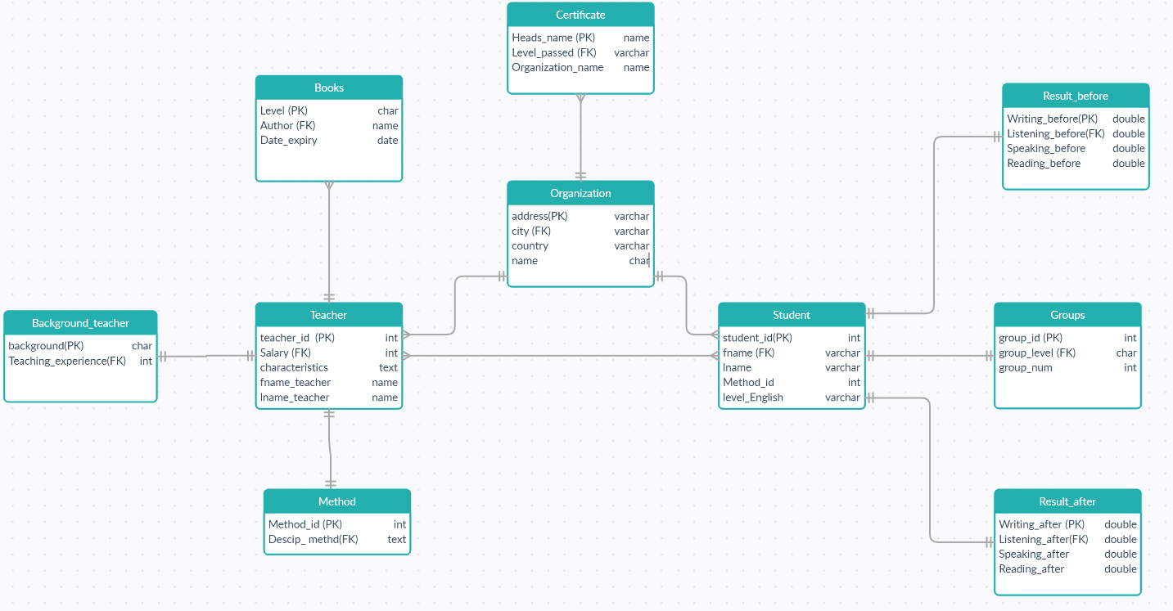
Beginning of the project:
main body

Slide 7
17.11.20-20.11.20

Slide 8








Slide 9
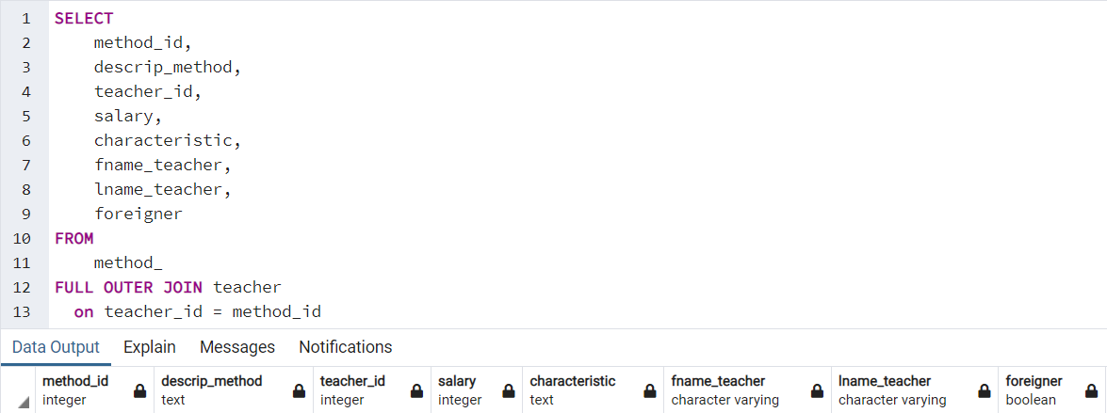

Slide 10
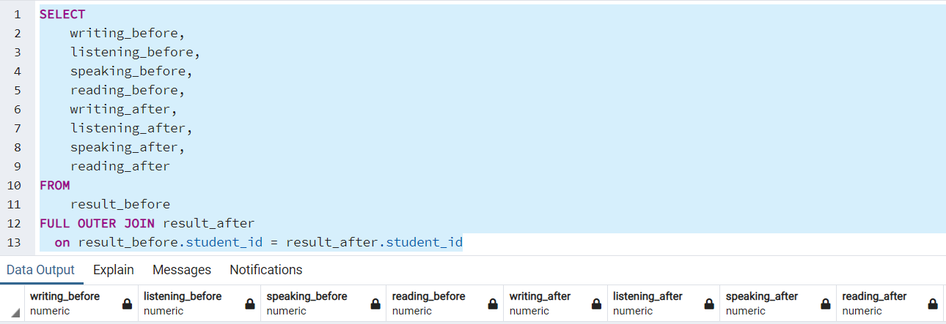

Slide 11
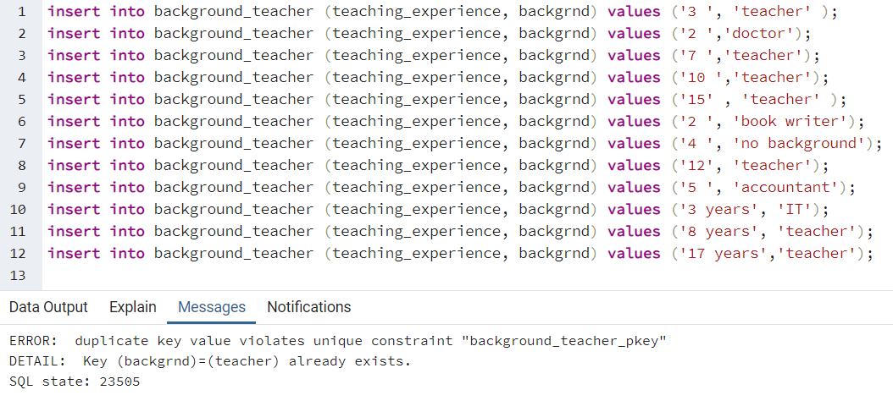
Challenges that I faced

Slide 12

What I have learned

Slide 13
Work is done . Thanks for your attention!!!!

Slide 14

My gantt chart
19.1
18.1
17.1
16.1
ER
tables
insert
join

